Slide 1
Predicting crime and criminality
Can “predictive policing” prevent crime before it happens?

Slide 2
Definition
Predictive Policing is the application of analytics and artificial intelligence for prediction, identification and precaution of any criminal activity
Notes:
Predictive policing is a relatively new concept, which refers to the use of computational techniques to identify potential criminal activity. It usually uses the data on the times, locations and nature of past crimes to provide insight to police for taking decisions on where the patrols should be,

Slide 3
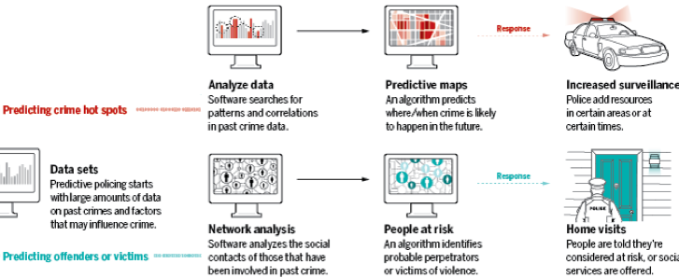
Common Approaches
Source: sciencemag.org
Notes:
There are several lines of research related to this topic. The most commons are the prediction of crime hotspots, and potential offenders or victims. The researchers usually use classification methods based o variables that are highly correlated with crimes events. I selected 4 cases of study for presenting today. 2 of them were academic articles, and the other two are algorithms that are being implemented by police departments.

Slide 4
A Case Study 1: Predicting crimes in LA and Denver
Data
Predicting Model
Outcome
Apriori algorithm
Spatial and temporal criminal hotspots
Type of crime
Occurrence time
Crime location
Potential crime type in a specific location within a particular time in the future
Naive Bayesian
Crime type prediction
Article “CRIME PREDICTION BASED ON CRIME TYPES AND USING SPATIAL AND TEMPORAL CRIMINAL HOTSPOTS”. Almanie, Tahani, Rsha Mirza, and Elizabeth Lor (2015)
Notes:
The first article makes the assumption that every crime has a signature. The pattern is affected by geographic location and time of crime. So, they used variables of crimes that happened in the city. The prediction occurred in 2 stages: One algorithm for finding patterns of location and time, and other was for classifying the type of crime. In this case, they used Naïve Bayesian classification method.

Slide 5
A Case Study 2: Predicting crimes using deep learning
Predicting Model
Deep Neural Network
Data
Outcome
Spatial feature group
Crime statistics
Demographics
Weather
Economics
Probability of crime and non-crime occurrences per region
Temporal feature group
Environmental feature group
Article “Prediction of crime occurrence from multi-modal data using deep learning”. Hyeon-Woo Kang, Hang-Bong Kang (2017)
Notes:
The second case took similar assumptions of the first cases, but also considered features related to the cause of crime, such as social indicators and the weather. In fact, there are several evidences that temperature affect crime rate. The authors of the research divided the data into 3 different features group, and applied Deep Neural Network separately on them. An finally the 3 results were fused and the outcome was the probability of crime and non-crime occurrences per region.

Slide 6
A Case Study 3 : Harm Assessment Risk Tool (HART) Predicts the risk of convicts reoffending (to be implemented in Durham, UK)
Data
Predicting Model
Outcome
Past offending history
Other background characteristics
Repeated offences
High Risk offenders –
a new serious offence
Random Forest for Classification
Moderate risk offenders –
any non-serious offending
Low risk offenders –
no offence
Notes:
The 3rd case I brought here was the project that is being implemented in a city in the UK. Different to the other cases, this one is focused on the individuals. It predicts the risk of convicts to repeat the offences. The data they use are the past offending ……. They applied Random Forest for classificating the offenders in 3 groups based on the risk level.

Slide 7
A Case Study 4 : Predictive Policing Software (PredPol) Research project between the Los Angeles Police Department and UCLA
Assumptions
Weather affects crime
Offenders search locally their targets
Repeat victimization (broken window theory)
Near-repeat victimization (effects on neighbors)
Field tests across 3 LAPD Divisions (21 months period)
Reduction of 7.4% in crimes
The research lead to the creation of PredPol, The Predictive Policing Company.
PredPol is deployed in over 50 police departments
Notes:
Finally, the last case I will introduce here is the software called PredPol. It was the result of a research project conducted jointly by the University of California and Los Angeles Police Department. It’s not open sourced, but the researchers explained the assumptions they make. First, is the weather, second, that offenders search locally their targets. Where they live, work, or where they girlfriend lives, because they prefer to act in places where they know well. The 3rd assumption is the repeat victimization, which is similar to the broken window theory. For example, houses that can be easily invaded by thieves, tend to be repeatedly a target. The near-repeat victimization is the effect on neighbors. For example, the houses that are near the ones with weak security are also target for thieves. The researches made a pilot project across some area in LA during 21 months. The result was the reduction of 7.4% in crimes in those areas. The reseach lead to the creation of the PredPol company, which deployed the software in over 50 police departments.

Slide 8
Conclusions
Pros:
Optimal allocation of police patrols
Prevent organized crime
Tool for Public Policy
Cons:
Crime displacement
Risk of false positive/negative
Risk of bias
Notes:
The predictive policing algorithms have proven to be a good tool for police strategists. It allows a better allocation of police patrols and for preventing organized crime. However it has received some critics. One of them is the crime displacement, once patrols concentrate in the hotspots, there’s the risk that criminals target other areas, also, there’s the risk of false positive/negative and bias. Since it’s a new tool, we still don’t have the long-term results. Time will tell. However, it can also be used as a tool for public policy. Policy makers can focus on those areas for tackling the causes of crime. For example, improving the schools, better social assistance, etc.

Slide 9
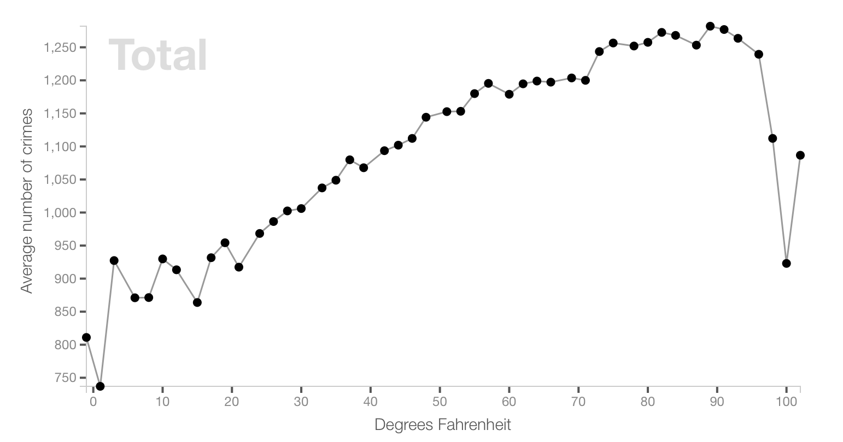
Crime vs. Temperature in Chicago

